Slide 1
Linear Programming
Zhiyuan Wang 12032878
Supervisor: Ke Tang

Slide 2
Content
Greedy Set Cover Algorithm has best result
Price Method Algorithm has best result
LP-based Algorithm has best result

Slide 3

Linear Programming Software
The software which I use is Mathematica. It is a numerical calculation software published by the Wolfram company.
In all of the example follow, I will use Mathematica to verify the result that I calculated by Python.

Slide 4
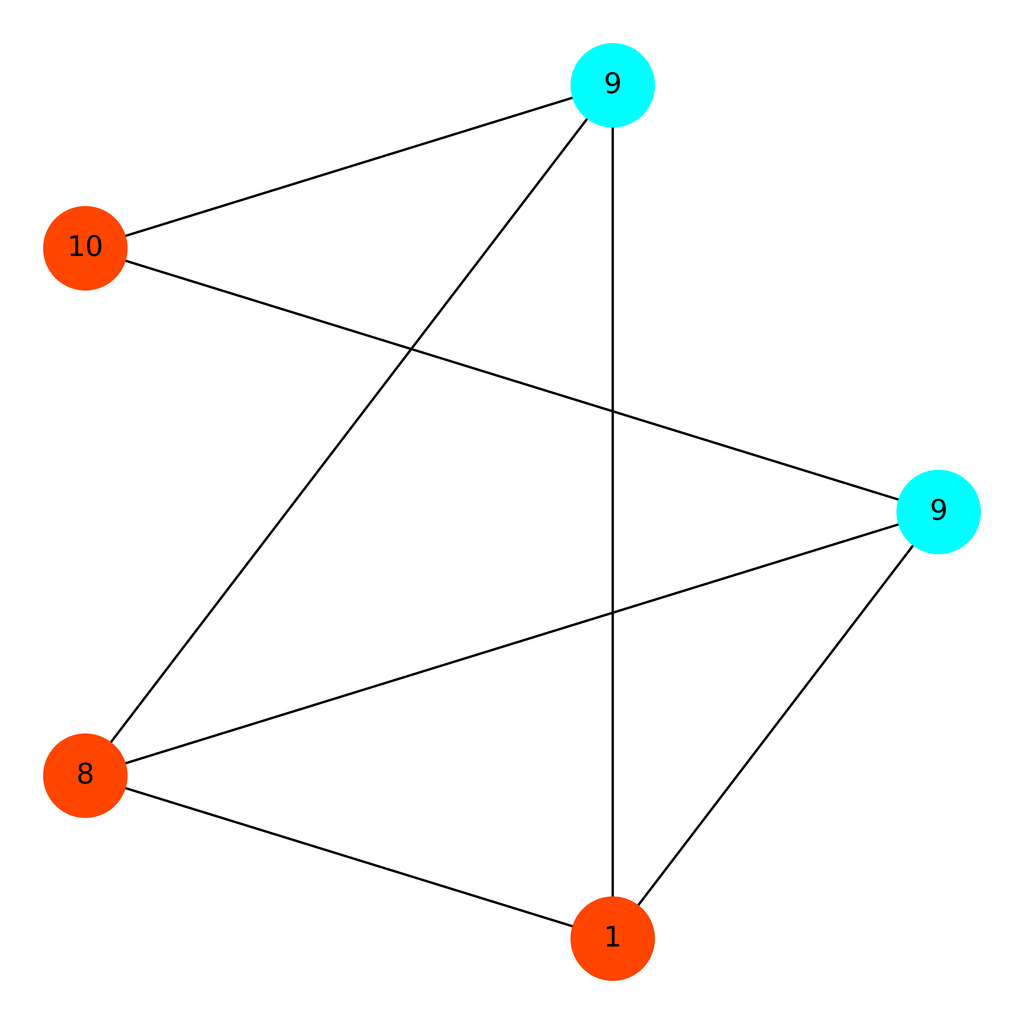
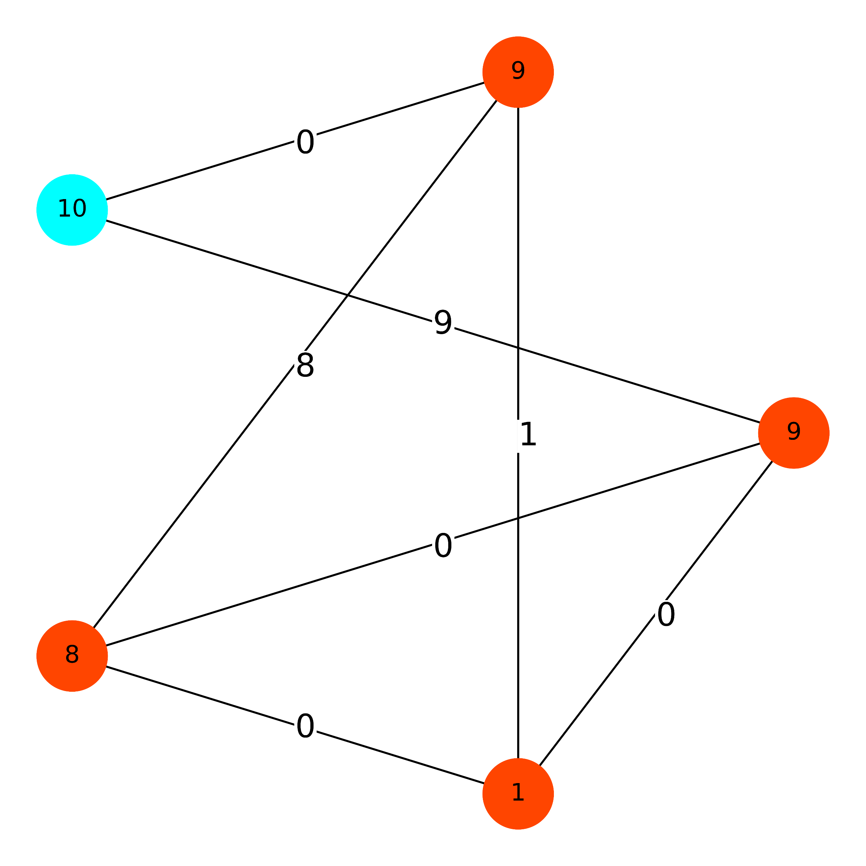
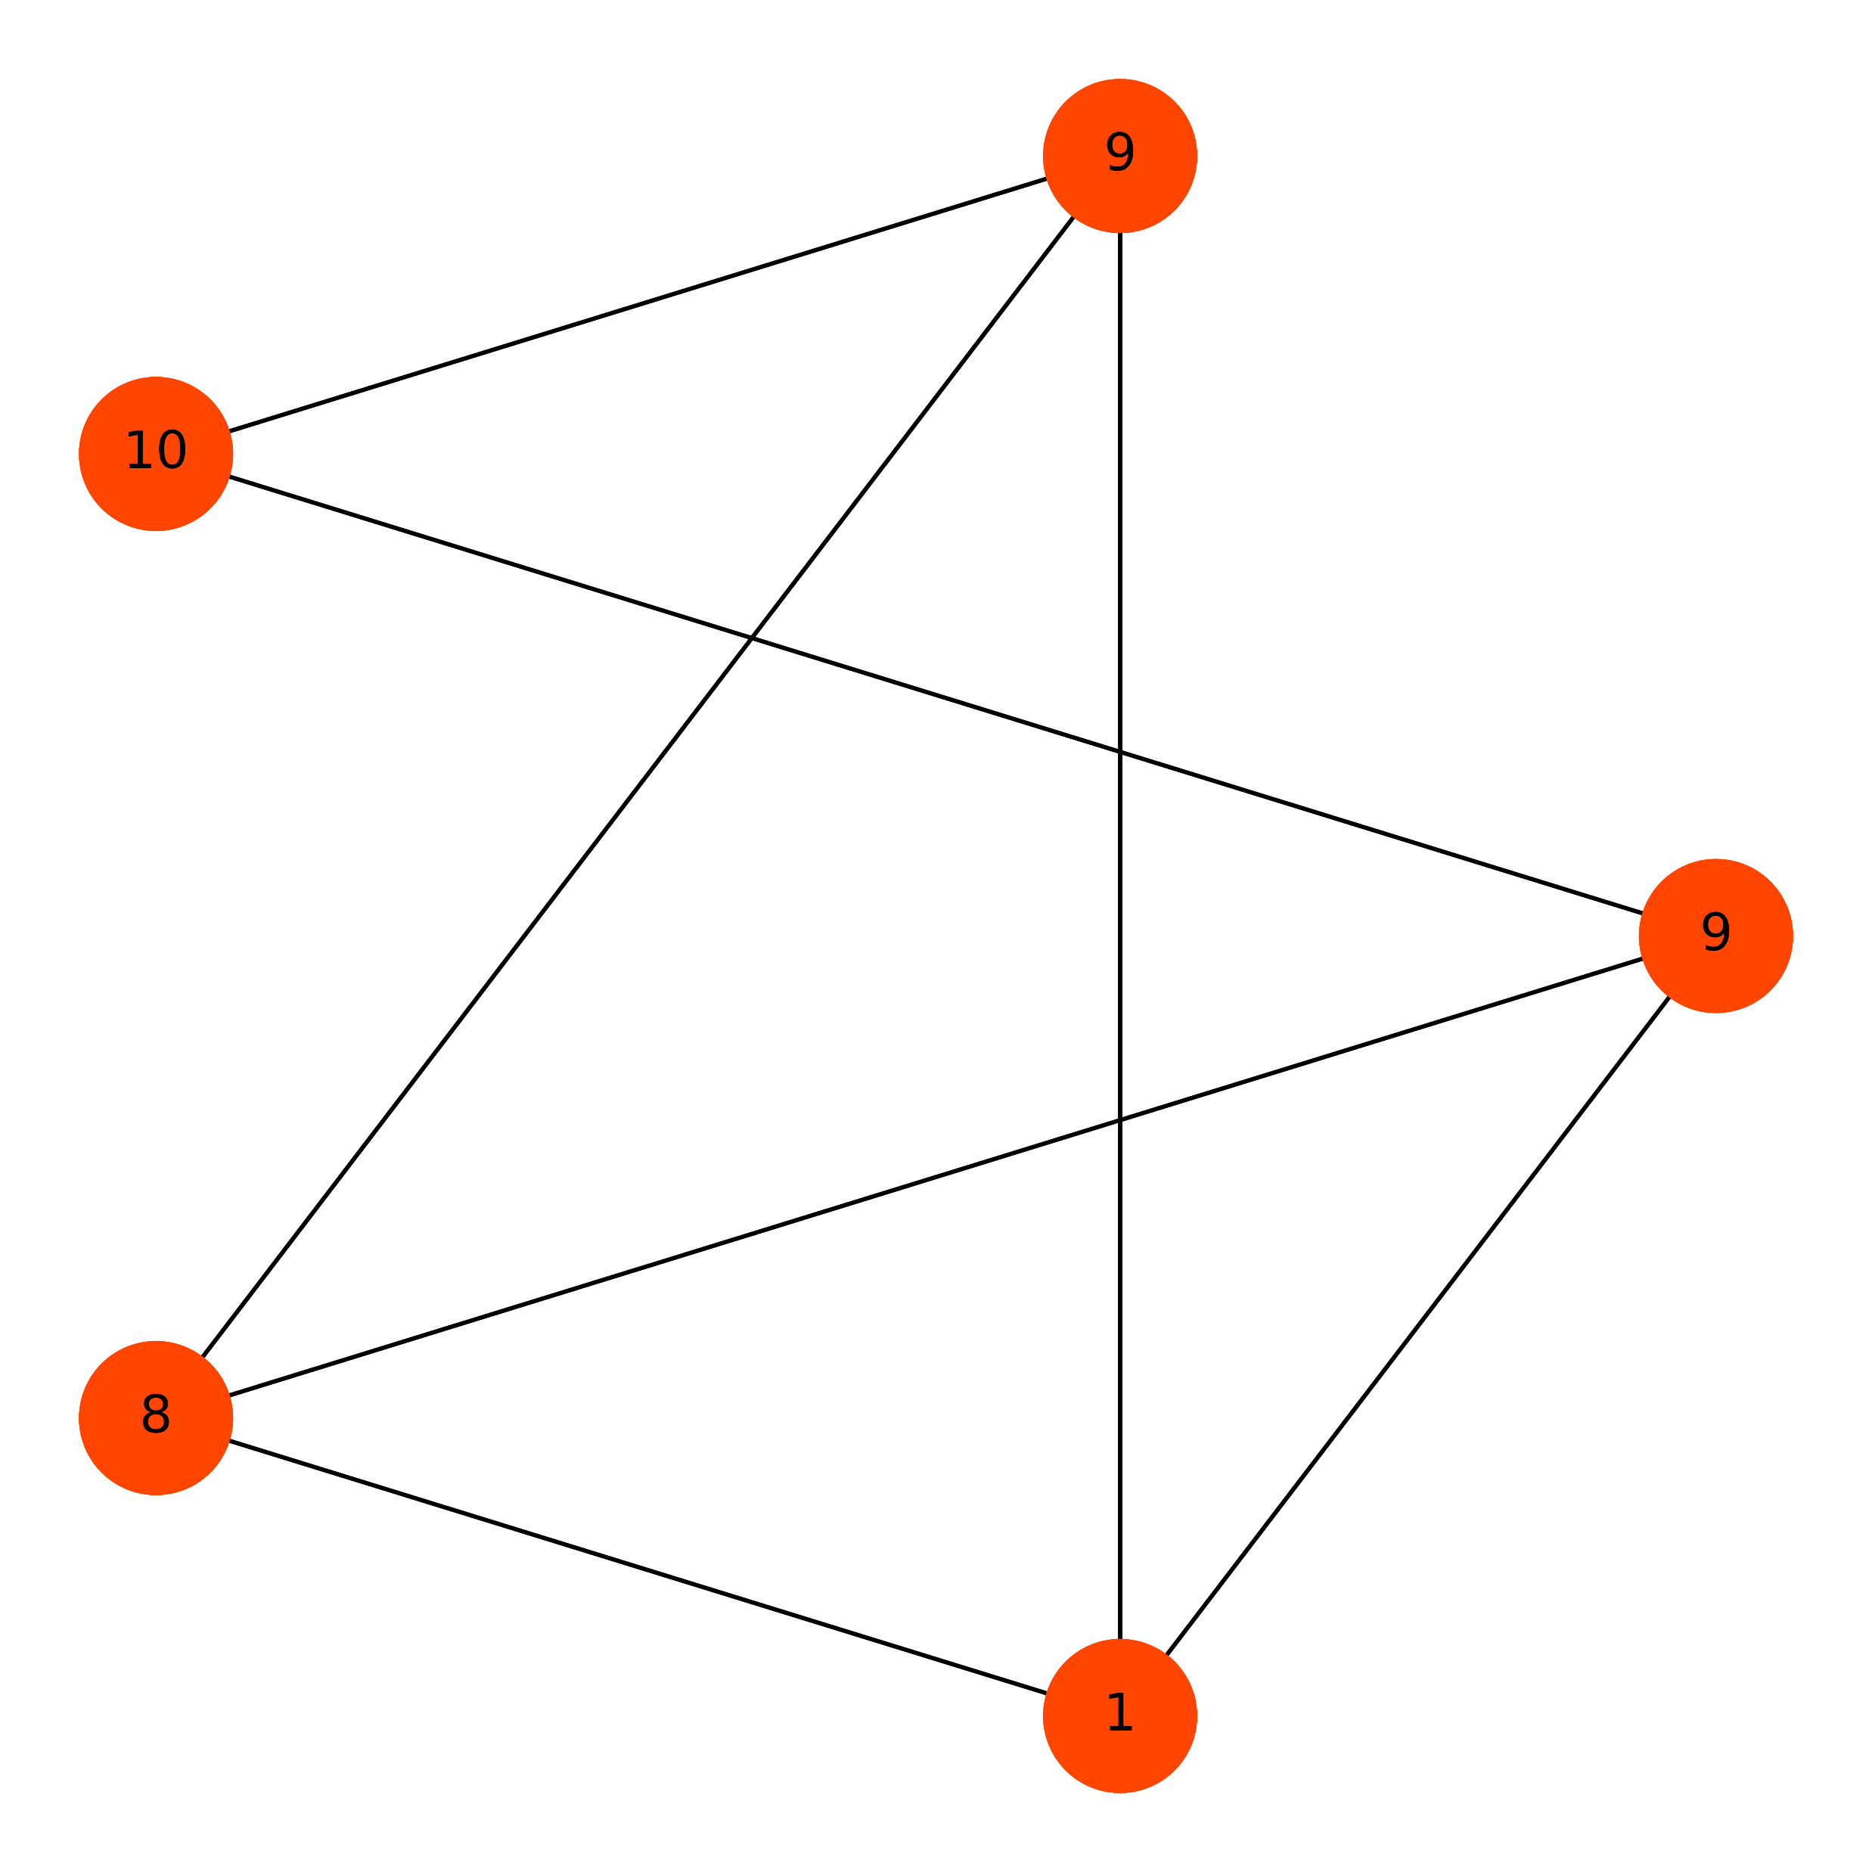
Greedy Set Cover Algorithm has best result
Order
Independent !
Result From Greedy Set Cover
Cost is 19
Best Result From Price Method
The min cost is 27
Result From LP-based
Cost is 47

Slide 5
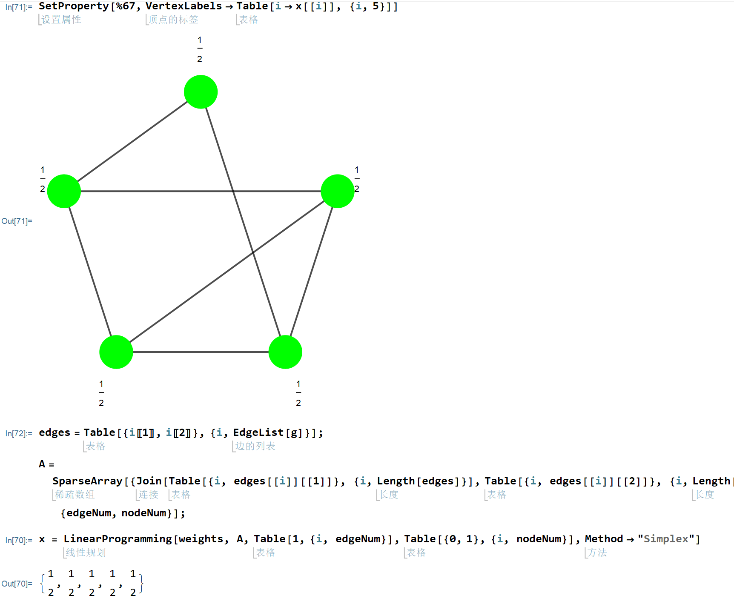
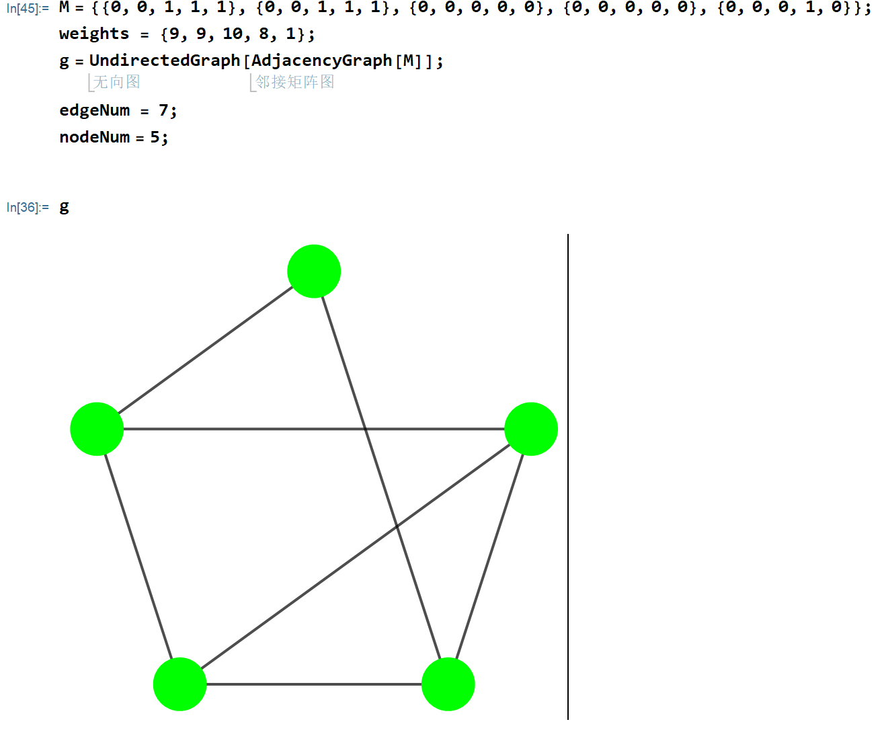
LP Result From Mathematica

Slide 6
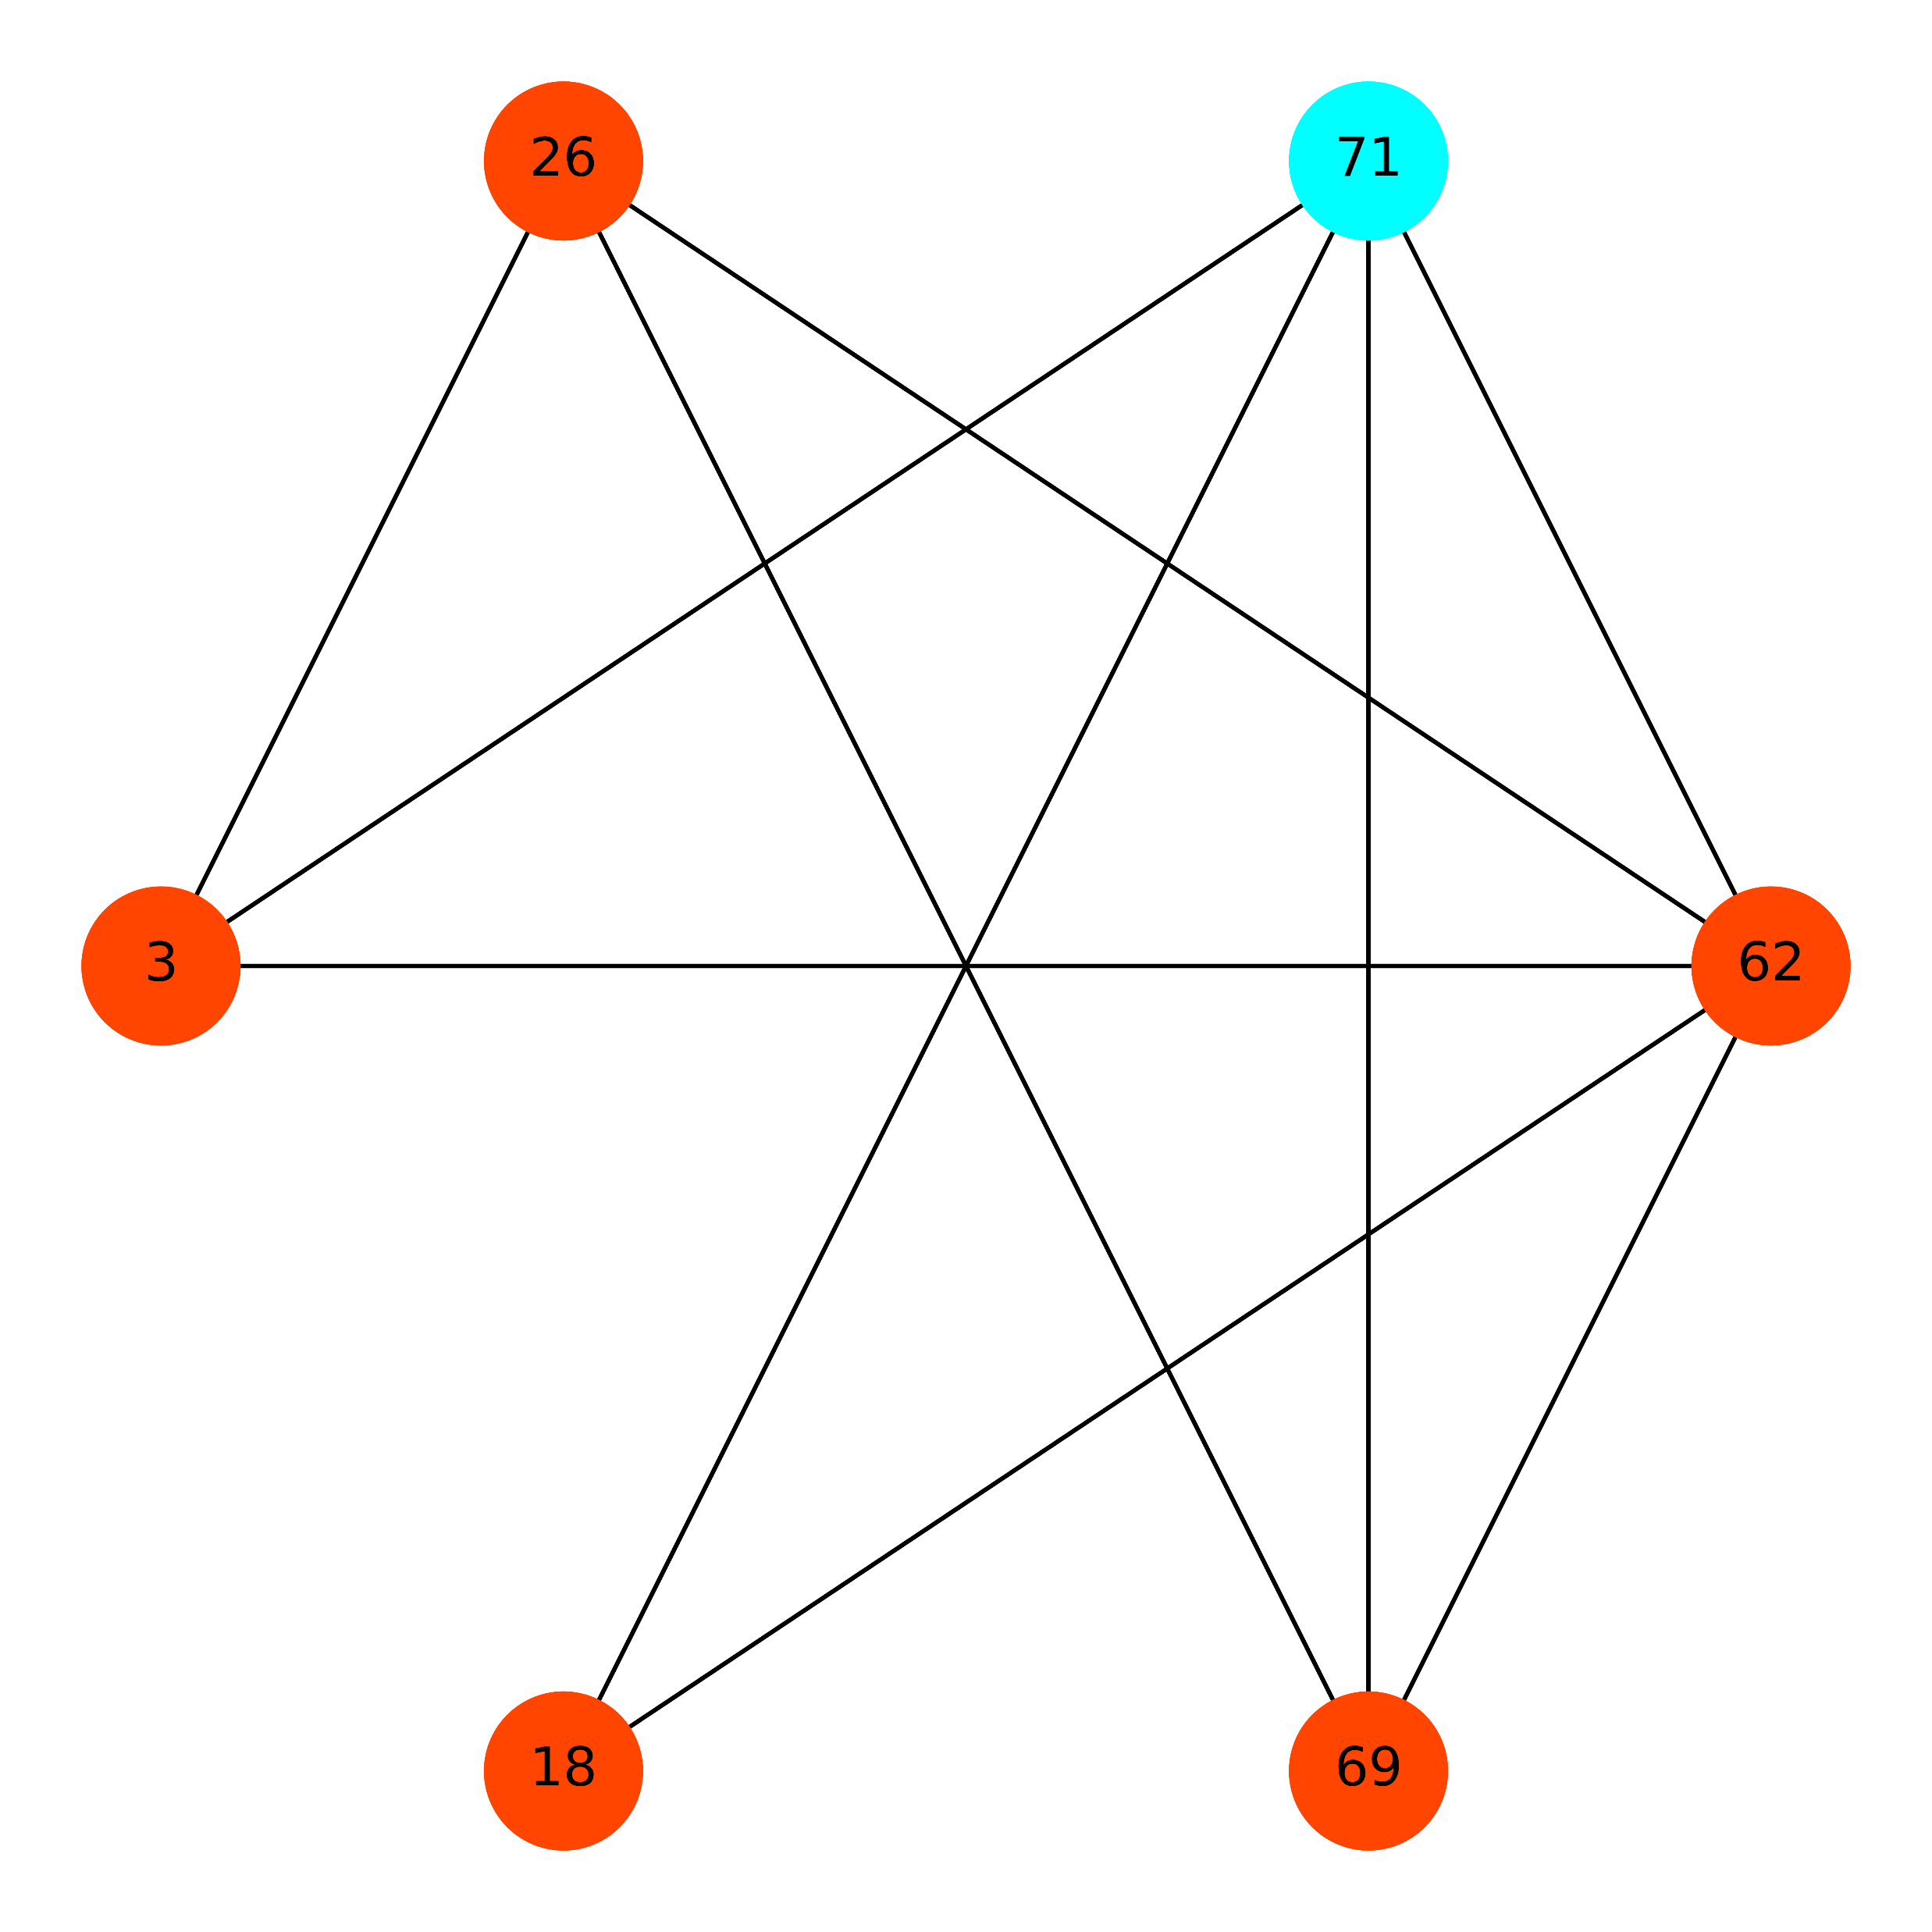
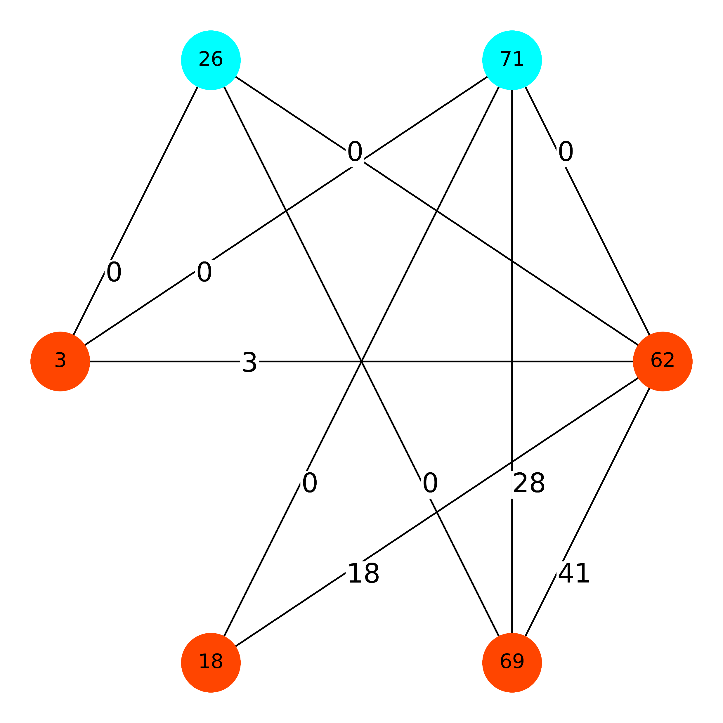
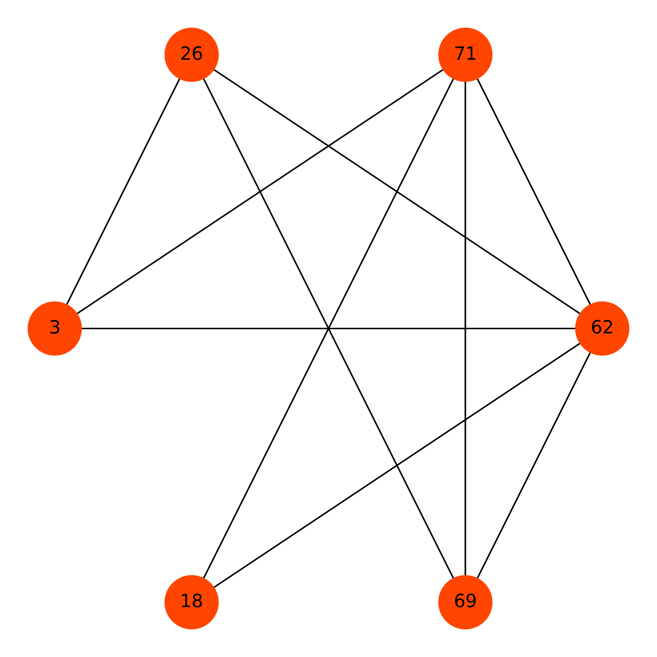
Price Method Algorithm has best result
Depend on
The Order (TwT)
Result From Greedy Set Cover
Cost is 178
Best Result From Price Method
The min cost is 152
Result From LP-based
Cost is 249

Slide 7
LP Result From Mathematica

Slide 8
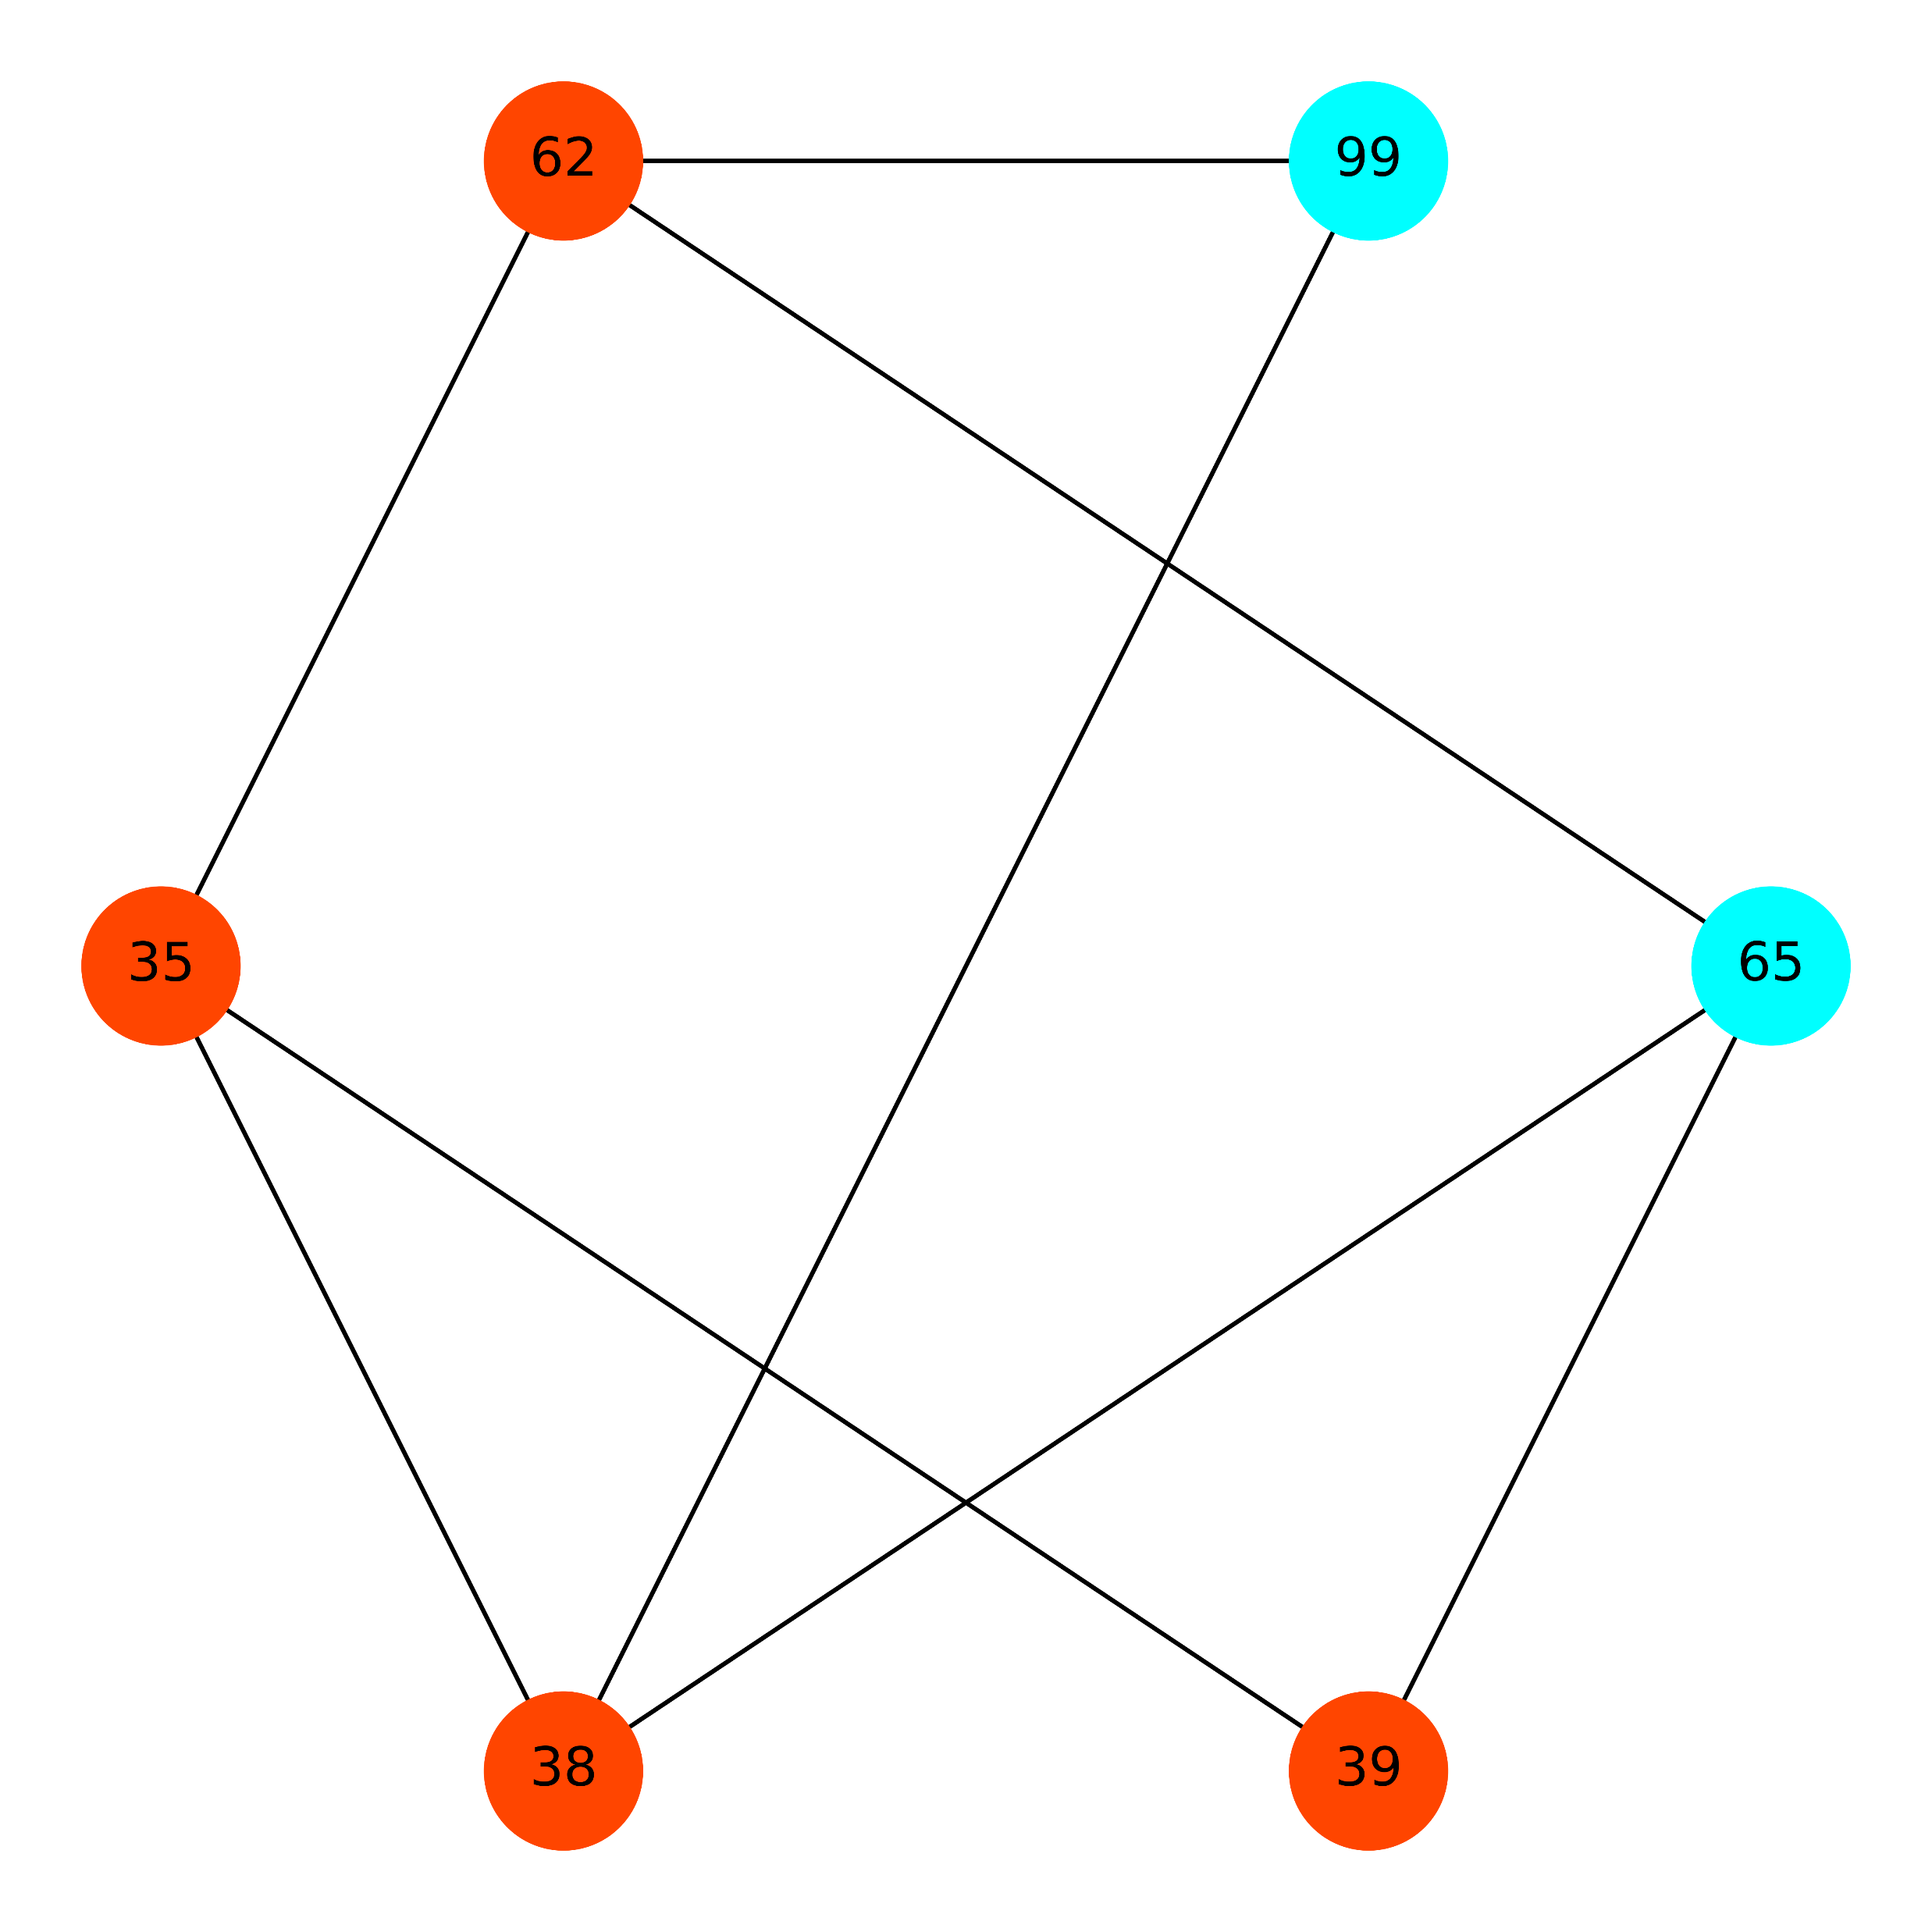
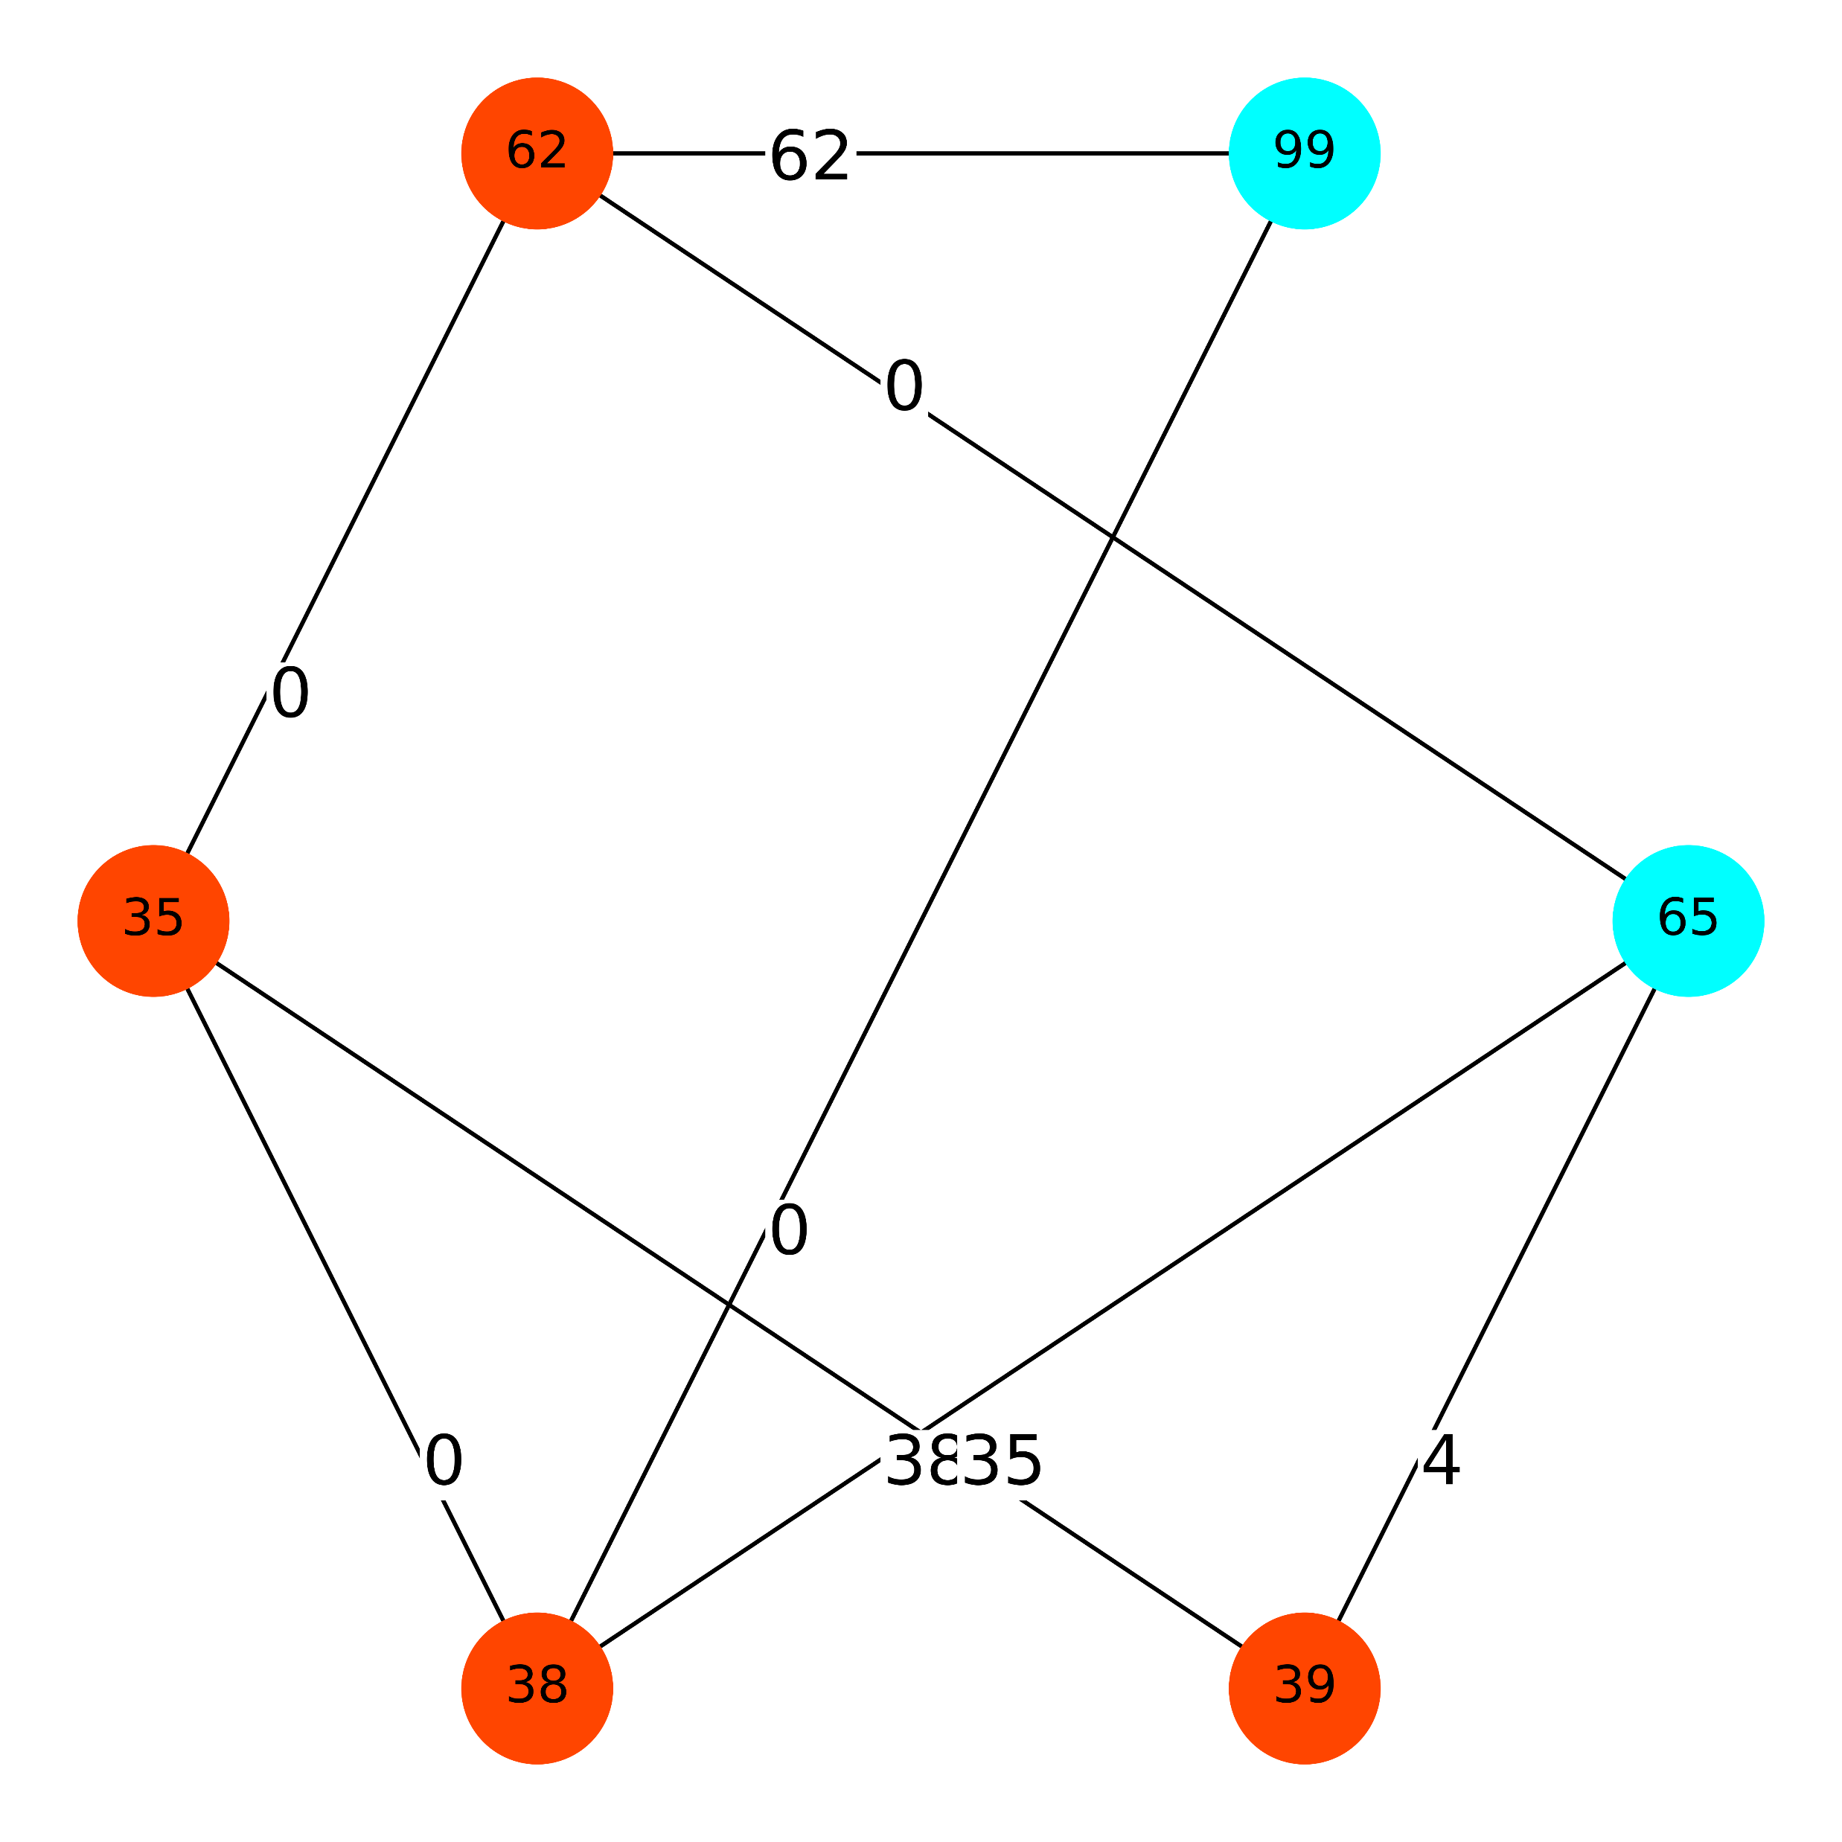
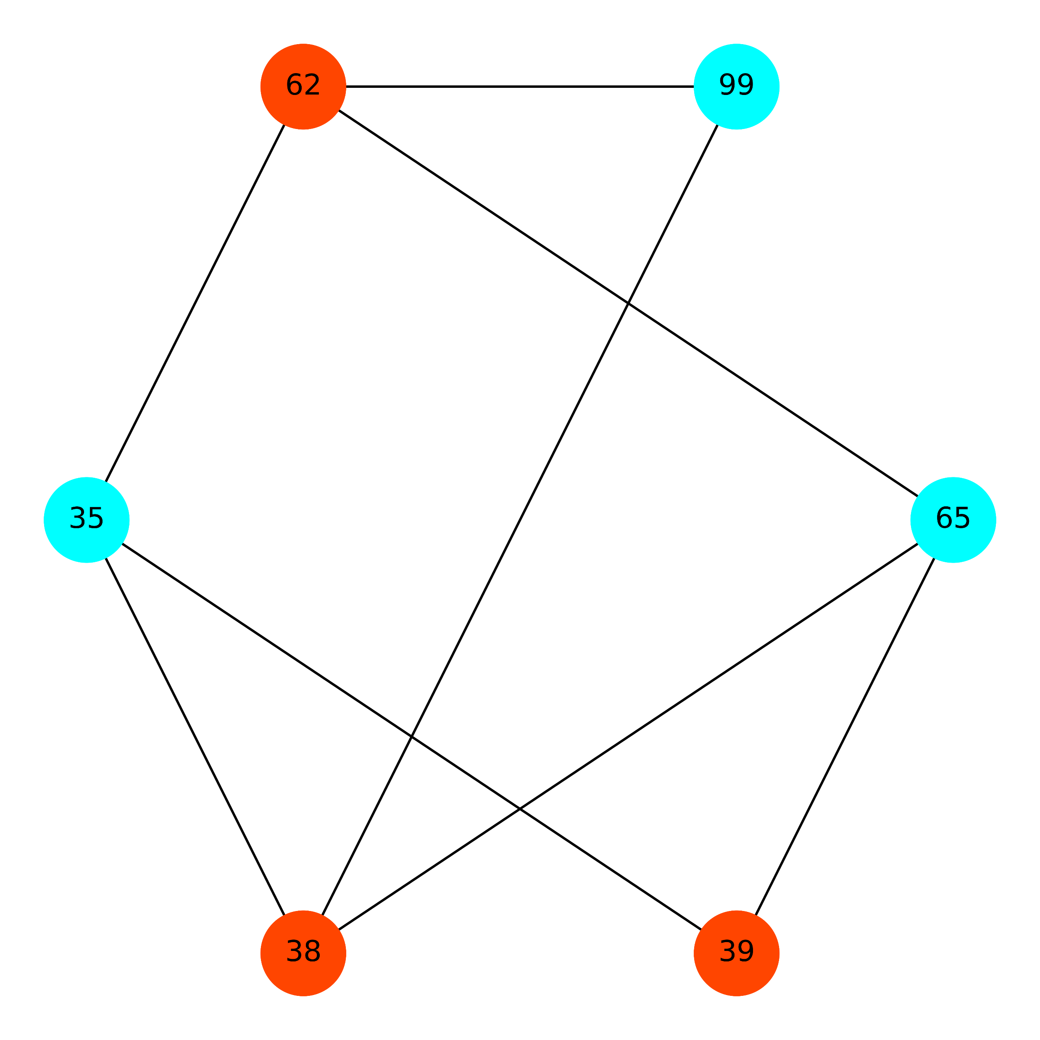
Greedy Set Cover Algorithm has best result
Order
Independent !
Result From Greedy Set Cover
Cost is 174
Best Result From Price Method
The min cost is 174
Result From LP-based
Cost is 139

Slide 9
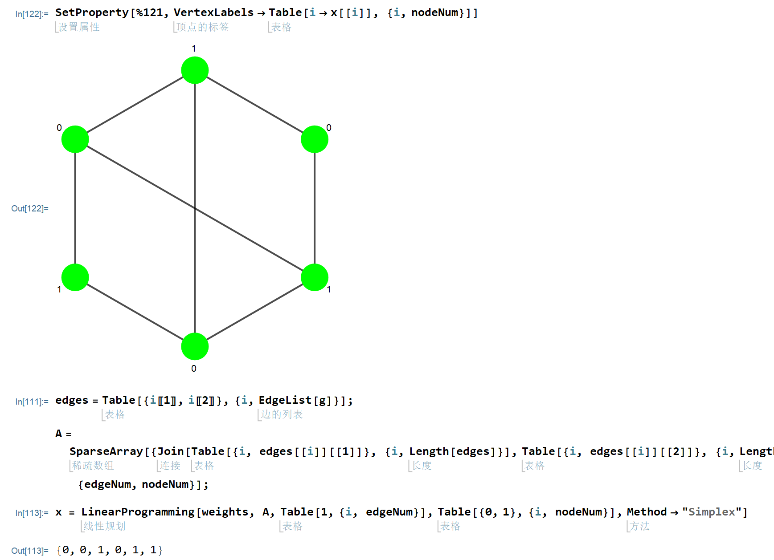
LP Result From Mathematica

Slide 10
Thank You !
Q&A

